Slide 1
Michael R Nelson, Senior Researcher MNELSON@POBOX.COM
Creating Your Transparency Strategy the Age of Wikileaks
Notes:
Businesses have always faced conflicting demands for information openness and sharing vs. information security and privacy
But the general trend toward more openness is unstoppable, as information becomes a dominant business driver, and as individuals, firms and governments are all expected to be more transparent
While the risks of more transparency are well understood, many firms have not systematically thought through the potential benefits in areas such as R&D, product development, sales, marketing, and recruitment
Thus, every firm has an implicit transparency strategy, but relatively few have an explicit one. Explicit discussions are needed to overcome legitimate security concerns, and the bias toward “worst case” thinking
Developing an effective transparency strategy requires CXO commitment, as well as IT, legal, marketing, and HR support.
Strategies will vary widely by company, industry, and geography, but every firms faces basic questions of internal and external positioning
While this issue in its very early stages, the LEF has developed a number of models to help firms think through the many issues involved

Slide 2

Introduction – today’s digital environment
More data; less control
Employees expect information access on demand
Social media greatly expands information sharing possibilities
“Open Science,” “Open Data,” create major new innovation platforms
More public skepticism; less societal trust
Increasingly punitive business environment
Multi-gigabyte storage devices for less than $20
Increasing regulatory oversight and reporting demands
More “eyes” watching; everyone’s a potential blogger, whistleblower
More powerful analytical and semantic tools to link and decipher data

Slide 3
Information management – what’s changed?
In the last 20 years:
100s of times more data (e-mail, CRM, social media, video, etc)
Greater need to share that data (internally and externally)
Easier to copy, leak
Company walls becoming porous (ecosystems, Cloud)
Data becoming an ever-more important source of value
Greater transparency increasingly expected (by customers and investors)
100
10
1
Data
Sharing
Control
1990 2000 2010

Slide 4



WikiLeaks puts transparency on the agenda
Web site launched in late 2006 using advanced technology to enable documents to be leaked anonymously
April 2010: WikiLeaks publishes video of a helicopter attack in Baghdad in July 2007, which shows Iraqi civilians and journalists
being shot
July 2010: WikiLeaks releases more than 75,000 documents from the war in Afghanistan, mostly field reports from troop actions
October 2010: WikiLeaks works with
major global news organizations to release
the Iraq War Logs, containing almost
400,000 documents
November 2010: WikiLeaks begins
releasing some of 250,000 US State
department diplomatic cables, many
of which are classified CONFIDENTIAL
ALL of this material is thought to have
been compiled and leaked by a single
disgruntled intelligence analyst in Iraq,
Private Bradley Manning

Slide 5

First impulse: Lock down everything
From governments:
  Panic – then a renewed focus
  on cyber-security
  Efforts to impede or close
  down WikiLeaks,
  Charges against Julian Assange
From businesses:
  Disassociation from WikiLeaks (e.g. Amazon, PayPal)
  Response planning --
  What if it happened to us?
  (e.g. Bank of America)
From hacker community:
  Wikileaks sympathy
  Counterattacks (Anonymous, et al.)

Slide 6

Upon further consideration
If thousands of people had access to the data Private Manning allegedly leaked, can everything really be kept confidential?
Modern organizations are going to become more transparent, whether they like it or not
A lot of the leaked data actually made the US State Department look more capable and more human
What data and information that we always considered confidential should we make available online – and how could we leverage the disclosure of that information?
Can we benefit from ‘strategic leaking’ in order to foster more publicity and interest in our work?
How can we best avoid unwanted hacktivist attention?

Slide 7
Good News, Bad News, No News
Routine
Reports
Bad
News
Good
News

Slide 8

Classic Public Relations
Routine
Reports
COVER UP
Bad
News
Good
News

Slide 9
Really Good Public Relations
Routine
Reports
COVER UP
& SPIN
Bad
News
Good
News

Slide 10
Really Good Public Relations
Routine
Reports
COVER UP
& SPIN
Bad
News
Good
News
+
Phony
Good
News

Slide 11

What Wikileaks and Bloggers Do
Routine
Reports
BAD NEWS
LEAKS FIRST
Bad
News
Good
News

Slide 12

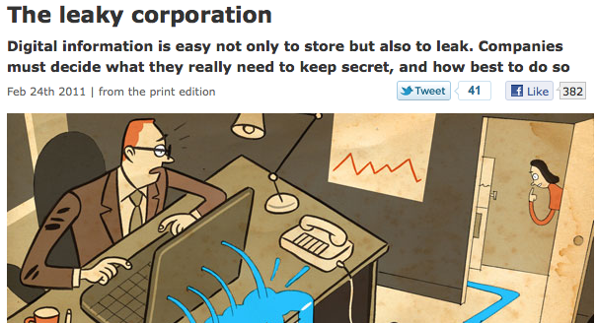
The Economist on transparency

Slide 13
Driving Cultural Change from the Outside In
External
Legalistic
Collaborative
Licensing
Non-disclosure
Compliance
Open Innovation
Speed and agility
Publicity/reputation
Secrecy
Transparency

Slide 14
Driving Cultural Change from the Outside In
External
Legalistic
Collaborative
Licensing
Non-disclosure
Compliance
Open Innovation
Speed and agility
Publicity/reputation
Secrecy
Transparency
Locked-down
Learning
Hierarchies
Silos
Need-to-know culture
Flat organizations
Information sharing
Participatory culture
Internal

Slide 15
Two main transparency goals – more value and/or more accountability
High
Transparent
– Publicity/trust
– Sharing/IP
– New data platforms
Open
– Transparency as default
– Internal = external
– 360 degree sharing
Value
Creation
Opaque
– Need to know
– Mgmt whims
– Black box
Traceable
– Compliance
– Visibility
– Responsibility
Low
Accountability
High

Slide 16
Major areas of potential transparency
Thoughts and opinions of the CEO and key employees
Research and product plans (even source code and other IP; open science)
Personnel data (bios, contact information, job focus, even salaries)
Sales goals and figures
Customer data (anonymized)
Customer complaints and resolutions
Pricing and purchasing data
Everyday operations -- schedules, events, webcasts
Crisis response
High
Value
Lo
Accountability
High

Slide 17

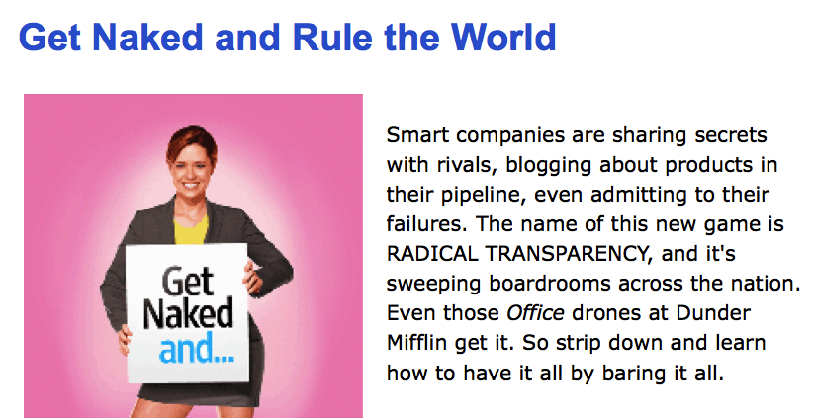
Radical transparency
WIRED, March 2006

Slide 18


1. Sharing CEO’s and employees’ thoughts
Why do it?
Inform and inspire team
Drive strategy and values
Communicate with customers/partners
Build trust
Increase personal visibility
Why not?
Ammunition for lawsuits
Violate financial
disclosure regulations
Half-baked ideas
Lexus/Nexus effect
(you can’t erase the Web)

Slide 19

2. Sharing product plans (even source code!)
Innovation in the open:
  Linux and other open source projects
  Eli Lilly and GlaxoSmithKline drug trial data

Slide 20
2. Sharing R&D and product plans
Why do it?
Demonstrate leadership
Attract attention, generate buzz
Attract employees, partners, advisors, potential customers to build ecosystem
Instill ‘need for speed’ among employees and partners
Increase quality of work (because ‘the world is watching’)
Influence standards (formal and de facto)
Solve hard problems, shared challenges
Test, benchmark competitiveness
Why not?
Lose first mover advantage
Help competitors
Forfeit IP

Slide 21

3. Sharing personnel information
Examples:
United States Congress
Bell, California, scandal:
  California State Controller John Chiang publishes city officials’ salaries online
Ricardo Semler and Semco

Slide 22
3. Sharing personnel information
Why not?
Poaching
Reveal corporate strategy and product plans
National employee privacy rules
Demoralize the lowest performers
Potential frictions
Why do it?
Raise employees’ profiles (and morale)
Help employees win external recognition
Build trust
Foster internal (and external) communication
Improve recruiting
Let employees see they are paid fairly
Establish culture of merit

Slide 23

4. Sharing sales figures
Examples:
Amazon book rankings
Movie box office receipts
New York Times book and e-book sales

Slide 24
4. Sharing sales figures and goals
Why not?
Alert potential competitors
Scare customers, investors
Reveal bad strategy choices
Why do it?
Generate buzz
Help managers and employees retarget resources
Attract partners
Find opportunities for bundling
Peer pressure, greater accountability
Establish new norms

Slide 25
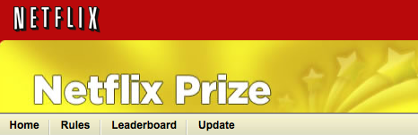
5. Sharing customer data (anonymized)
Examples:
CT TyMetrix data on legal bills at Wolters Kluwer
Data.mint.com at Intuit
Netflix
    Improve the accuracy of predictions about how much someone is going to enjoy a movie based on their movie preferences.
    $1 million awarded on 21 September 2009

Slide 26
5. Sharing customer data (anonymized)
Why not?
Customers’ privacy concerns
Reconciling various national privacy regulations
De-anonymization
(e.g. AOL user data fiasco)
Truth in advertising rules
Hacking and abuse
Other companies profit from your data
Why do it?
Inform and build the ecosystem
Help partners collaborate more effectively
Enable new services (e.g. Amazon book rankings)
Build customer loyalty, trust
Get more value from data
Establish new platforms for value creation

Slide 27






6. Sharing customer complaints
Examples:
Leading Edge Forum
9/19/11 12:24 27

Slide 28
6. Sharing customer complaints, resolutions
Why not?
Expose problems
Old embarrassments persist
Fodder for competitors who will target unhappy customers
Why do it?
Early awareness
Assure effective resolution
Pre-empt third party sites
Learn customer workarounds
Build customer trust
Track progress over time

Slide 29
7. Sharing pricing and purchasing data
Why do it?
Convince customers they are getting a fair deal
Simplify negotiations with customers and suppliers
Build customer loyalty (e.g. Jet Blue, Southwest Airlines)
Invite better offers from new vendors
Competitive differentiation
Build trust
Why not?
Rules against price fixing
Harder to get lower (secret) prices from vendors
Harder to price discriminate (by geography or customer)
Non-disclosure agreements with vendors

Slide 30

8. Day-to-day operations (schedules, webcasts, webcams)
Examples:
Webcams from ski resorts, hotel lobbies, cruise ships

Slide 31
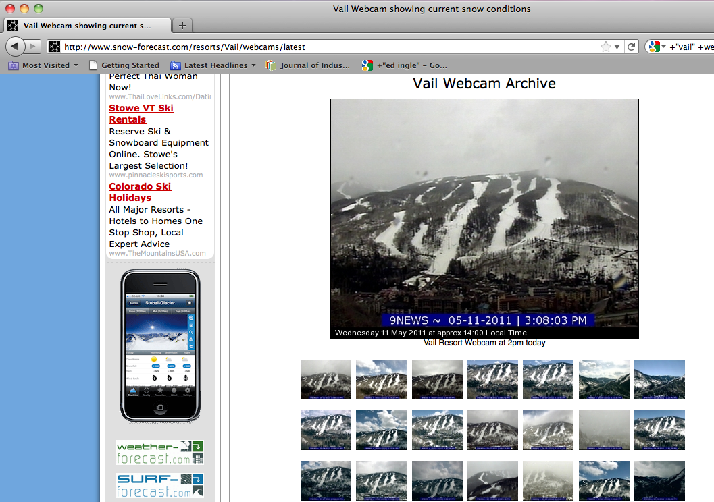
Leading Edge Forum
9/19/11 12:24 31

Slide 32
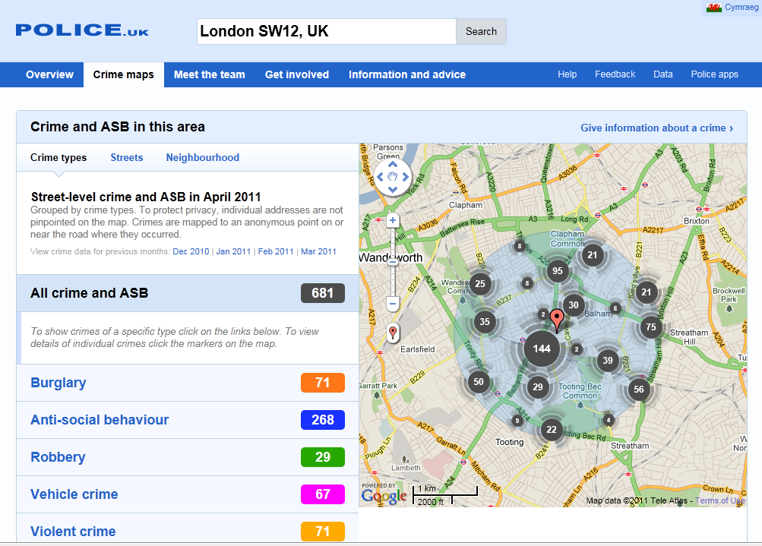
8. Day-to-day operations (schedules, webcasts, webcams)
Examples:
Webcams from ski resorts, hotel lobbies, cruise ships
Sunlight Foundation and Congressional schedules
White House visitor logs
Data.gov, data.gov.uk
  Crime statistics, e.g.

Slide 33

8. Day-to-day operations
(Examples from government watchdogs)
New Report from the
Transparency & Accountability Initiative
of the Open Society Foundation
Examples:
Citizen access to policy debates
Ushahidi for election monitoring
Tracking legislation
Citizen complaints
Lessons:
Visualization, mapping, social media key
Best to partners with outside groups, online
service providers, etc.

Slide 34
8. Sharing day-to-day operations (schedules, events, webcasts
Why do it?
Generate publicity
Show a human side
Foster ecosystem
Enable unplanned encounters
Why not?
Unscripted moments
Violation of financial disclosure regulations
Bad PR (Microsoft’s Ballmer ‘monkey video’)
Reuse and remix
Accuracy of data?

Slide 35
9. Sharing before and during a crisis
Why do it?
Provide context
Develop trust (esp. among press, investors, and analysts)
Get more information out faster (to public and employees) >> faster response
Correct inaccuracies
Why not?
Incorrect/preliminary data
No time for spin, analysis
Give critics ammunition

Slide 36
Trust and transparency
Trust tension
(Customers)
(Vendors)
Privacy Identity
0% Amount of Disclosure of PII 100%

Slide 37
Trust and transparency
Trust tension (cont)
Identity
Personalization
More Profits
Privacy Less Fraud
0% Amount of Disclosure of PII 100%

Slide 38
Trust and transparency
Redefining the debate
(Customers + Vendors)
Transparency
Disclosure about systems
and processes
Privacy Personalization
0% Amount of Disclosure of PII 100%

Slide 39

Emerging practices
  Clear agreement among relevant divisions on what level of transparency is desired (IT, Communications, PR, Legal, HR, Marketing, Board, CEO)
  Clearly stated, consistent policies on confidentiality
  and transparency; Avoid worst-case thinking
  Effective employee training on data policies
  Coordination with partners and vendors (especially content management)
  IT infrastructure that can monitor which data goes where (to whom)
  Mechanisms and metrics for measuring impact of openness (in terms of profits, partners, web hits, morale, customer satisfaction)

Slide 40

Governance
Who decides?
Legal
Human Resources
Public Relations and marketing
CEO and Board (when?)
IT
Centralized or decentralized approach?
Defining and promulgating policies
Regulatory issues

Slide 41

Implications for IT architecture
Effective, easy-to-use (or automatic) means for flagging sensitive information
Single sign-on and federated identity
Fine-grained access control and monitoring mechanisms
Wider use of end-to-end encryption (especially in the Cloud)

Slide 42
Your firm’s risk gradient probably looks like this
High
High
Potential Damage
Low
Low
Low
Value of Asset
High

Slide 43
… but your current Cost of Controls probably looks like this
High
Current Cost of Controls
Low
Low
Value of Asset
High

Slide 44
Which results in …
High
High
Underprotection
Crown Jewels at Risk >
Potential Impact
Overcontrol
(Waste of Money)
Low
Low
Low
Value of Asset
High

Slide 45
Classification provides a better approach …
High
High
Potential Impact
Cost of Controls Required
Low
Low
Low
Value of Asset
High

Slide 46

What to do today?
Start a discussion regarding company-wide transparency strategy
Study companies or government offices that have gained competitive advantage by becoming more transparent
Talk to IT vendors about need to release data (and manage its release) rather than just focusing on cyber-security
Survey employees on how well they understand current policy and where more clarity on confidentiality policy is needed
Consider transparency metrics (e.g. WorldBlu)
Get the IT team, marketing, and communications to brainstorm on possible pilot projects

Slide 47

Developing a transparency strategy
Determine goals and develop guidelines regarding disclosure of:
Thoughts and opinions of the CEO and employees
R&D and product plans
Personnel information
Sales figures and goals
Customer data (anonymized)
Customer complaints, resolutions
Prices and purchasing
Day-to-day operations
Crisis response
Create/identify point person and
high-level council to coordinate,
implement, assess

Slide 48
Where do you want to be?
Wide Open
10
Linux
G
Start-up
IA
DC
G = Google
IA = Intelligence
Agency
DC = Defense
Contractor
Internal
Lock Down
1
1 External 10
Lock Down Wide Open

Slide 49
Where do you want to be?
Benefit
Damage
Effort
1 External 10
Wide Open Total Lock-down

Slide 50
Bottom Line
You have a security strategy
You have a privacy and compliance policy
You need a TRANSPARENCY POLICY
The simpler the better. (But it will vary with sector, with type of information)
Examples:
Clinton White House: “Put it on Web unless there’s a good reason not to.”
Obama’s very first executive order went one step further and required data in open formats, but overall White House transparency still a mixed bag, subject to many conflicting pressures
Like security and privacy, transparency policies will continually evolve; there are real leadership and competitive differentiation possibilities.

Slide 51
Michael R. Nelson MNELSON@POBOX.COM

